Slide 1
Mining and Mineral Exploration

Slide 2
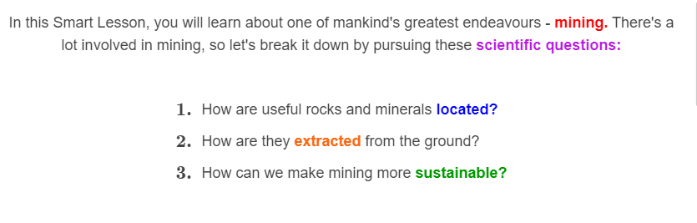
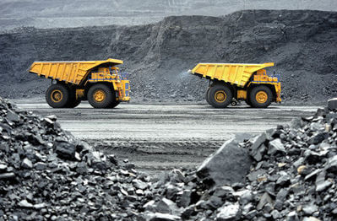

Slide 3
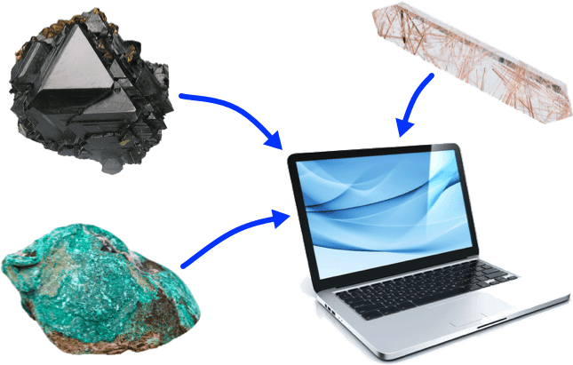
Consider this question, for starters. Where did all the metal parts of the computer you're using come from?
If you said, "From the ground," you're absolutely right! Metals such as iron, copper and titanium are all taken out of rocks. How cool is that?

Slide 4
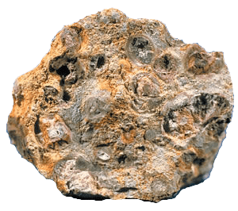
Rocks that contain valuable minerals are called ores. For instance, the ore bauxite is very rich in aluminium, which is used to build cars and other vehicles.
Australia provides almost one-third of all the world's bauxite!

Slide 5
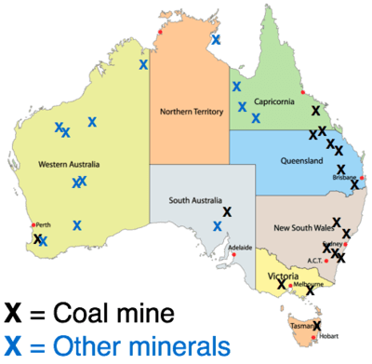
Australia has many useful resources that can be mined, including coal, gold, uranium, copper, iron ore, nickel, silver and bauxite.
Mining is the process of taking these resources out of the ground, or extracting them.

Slide 6
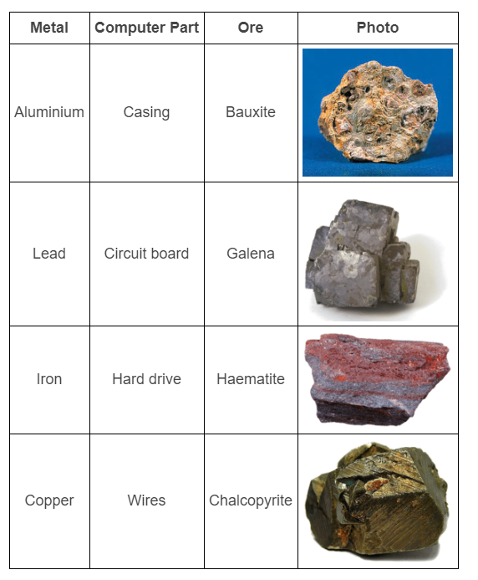

Slide 7

The first step in mining is to work out where the minerals are that contain the metals you want.
This process is called mineral exploration.

Slide 8
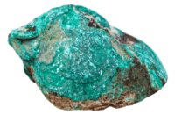
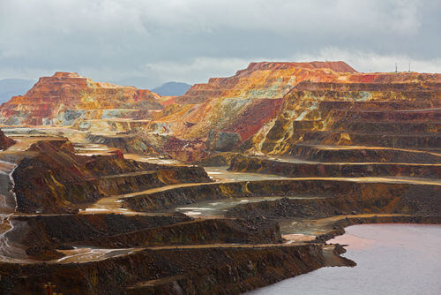
To work out where to start mining, geologists can look for certain colours associated with specific minerals. For example, copper has a blue or green colour that is easy to spot in ore rocks (right). Other minerals produce red or yellow colours, as you can see in the Spanish mine below:

Slide 9
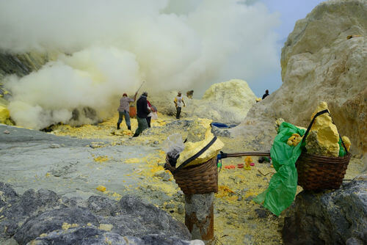
Some ores are easy to spot, but very hard to extract.
Check out this photo from the Kawah Ijen volcano in Indonesia. The yellow stuff is valuable sulfur, but getting to it means dealing with high temperatures and acidic gases! Can you imagine working in a place like this?

Slide 10
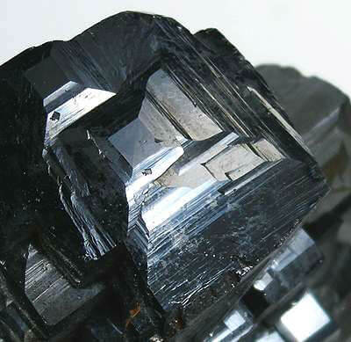
Minerals that contain iron, nickel or cobalt can be detected because of their magnetic properties; they stick to a magnet!
The mineral below is even called magnetite. Its properties can be explained using physics; the field of science that's all about forces, motion and magnetism.

Slide 11
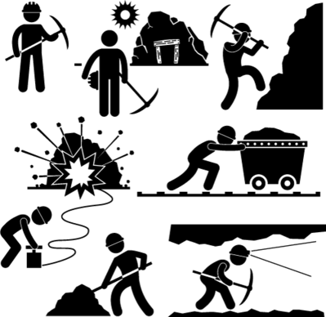
Mining is the process of removing minerals from the ground after they have been found by geologists.
There are different methods of mining, depending on how close the mineral ore is to the surface and what type of rocks are above it. Two common types of mining are opencast mining and underground mining.

Slide 12
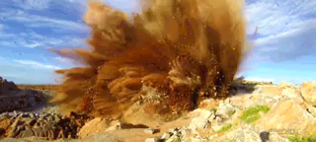
Opencast mining (or opencut mining) is used to extract minerals that are close to the surface.
The ore rocks are exposed by digging a large pit, then explosives are used to break them into manageable pieces! Trucks transport the ores out of the mine, so they can be processed elsewhere.

Slide 13
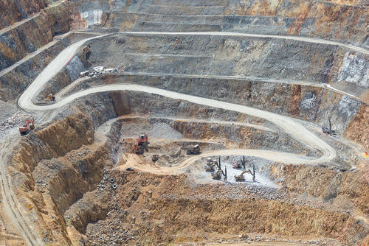
This photo is from an opencast mine in Waihi, New Zealand. People have been extracting gold from this pit since the 1970s. See if you can spot the trucks and diggers in the pit—they should give you an idea of how big it really is!

Slide 14
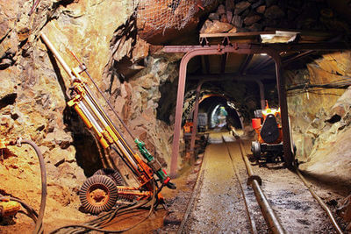
Underground mining is used when the mineral ores are deep below the surface.
Tunnels are dug out to reach an ore deposit. They can go as deep as 4 kilometres into the ground! The temperature tends to be quite high at this depth.

Slide 15

Underground mining is more dangerous than opencast mining, because of the risks of flooding, gas leaks, explosions or tunnels caving in.
If there are so many hazards, why should people dig into the Earth at all?

Slide 16
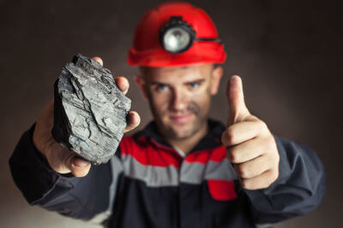
One thing we dig for is coal.
Coal is an extremely useful resource. It provides over 65% of Australia's electricity, but is also used for heating homes and to produce the steel in buildings!

Slide 17
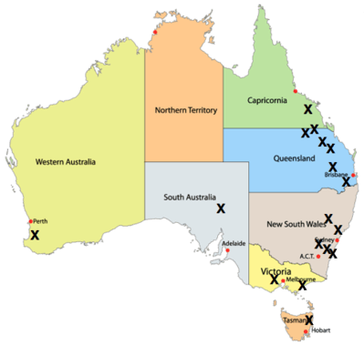
This map shows where major coal mines (X) are found in Australia. Most of them are around the east coast, close to where the big cities are:

Slide 18
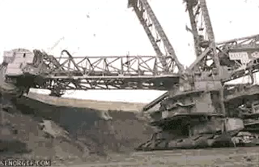
Coal isn't actually a mineral, but it can still be mined with opencast or underground mining techniques.
Opencast coal mining uses giant bucket wheel excavators to expose the coal beneath the surface. These excavators can be up to 80 metres long; that's almost the length of a football field!

Slide 19
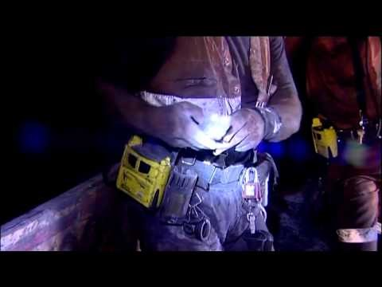

Slide 20
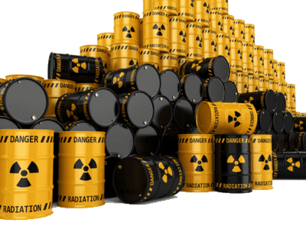
Although mining produces useful resources for society, it gets a lot of bad press. This is because the act of mining can have a huge negative impact on the natural environment. It's inevitable; you have to dig a giant hole in the ground to get ores out!
Nowhere is this more obvious than in uranium mining.

Slide 21
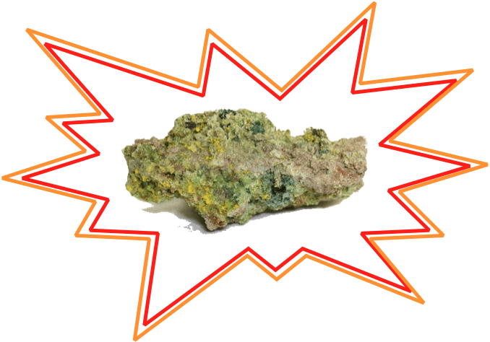
Uranium is a heavy, radioactive element found in rocks.
Radioactive things give off radiation that can pollute water, cause cancer and harm living things in other ways. Radiation is made up of energy and particles that are released when one element (e.g: uranium) naturally decays into another element (e.g: thorium).

Slide 22
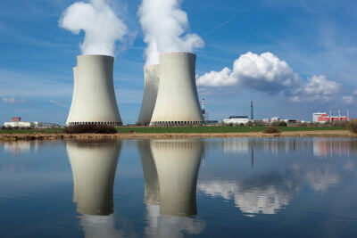
This stuff sounds dangerous, so why do we mine it?
Like coal, uranium is used as a fuel. Unlike coal, it is a type of nuclear fuel, which means it produces radioactive waste in power stations. In 2012, nuclear fuel provided over 10% of the world's electricity. That's a lot of power!

Slide 23
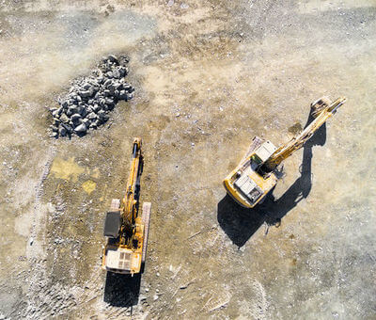
Australia produces 8.9% of all the uranium used on Earth for fuel.
Now we're going to look at three places where that uranium is mined. Then we will think about the consequences for people and for the environment.

Slide 24
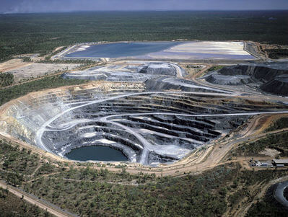
Opencast mining is used to extract uranium ore that is close to the Earth's surface.
Until the year 2012, this was done at Ranger Mine in the Northern Territory. The mine currently looks like this:

Slide 25
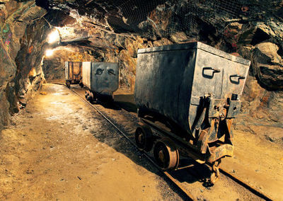
Underground mining techniques are used at Olympic Dam in South Australia. It's home to the largest known uranium deposit on the entire planet!
With deep tunnels, train tracks and old-timey carts, miners at Olympic Dam have been bringing uranium to the surface since 1988.

Slide 26
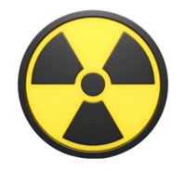
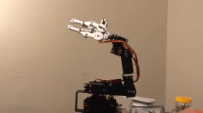
Remember how underground mining tends to be more hazardous than opencast mining? When uranium is the thing being mined, there's a whole new level of danger!
In the tunnels under Olympic Dam, miners have to wear protective suits to avoid being harmed by the radiation. In the future, this work might be done by robots instead because they don't get radiation sickness.

Slide 27
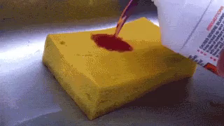
At Beverley Mine in the Flinders Ranges, miners use a different technique to extract uranium. They pump acid into it!
The acid in question is sulfuric acid, the same chemical that does this to a kitchen sponge:

Slide 28
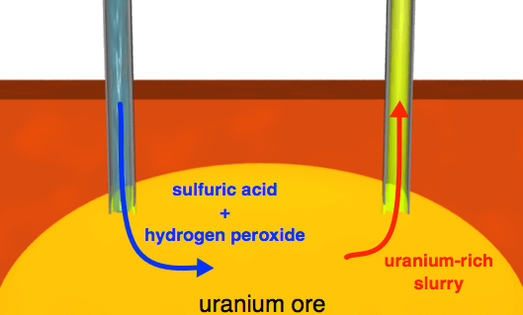
Extracting the uranium using acid is called in situ mining. It means people don't have to go underground at all!
Instead, a few holes are drilled into the ground. A mixture of sulfuric acid and hydrogen peroxide is then pumped down the drill holes. It dissolves the ore below and returns to the surface as a uranium-rich slurry.

Slide 29

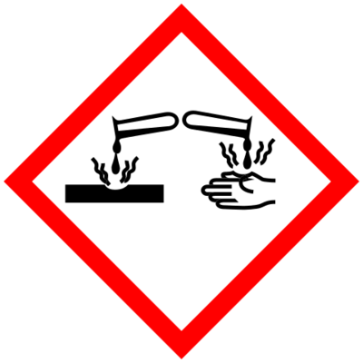
In some ways, in situ mining is safer than either opencast or underground mining. It doesn't require a huge pit or a deep tunnel to be cut, so there's no need for heavy machinery or explosives!
On the other hand, the slurry that comes up at Beverley Mine is radioactive, corrosive and extremely acidic. Stopping leaks and spills has always been a top priority for those working here!

Slide 30
Now you know about how coal and uranium are mined, let's take a look at a hot topic: environmental sustainability.
The first question to ask is, what does that term mean?

Slide 31

The first part of environmental sustainability refers to the natural environment that we share with every living thing in Australia.
Sustainability is all about protecting this environment and making sure its resources don't run out. Resources are not just minerals and rocks, they include things like water, air and soil, all of which are essential for life!

Slide 32
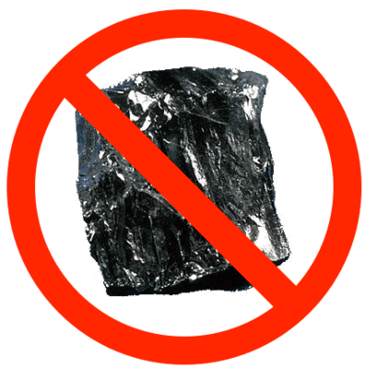
Coal and other ores are defined as non-renewable resources. That means they are being mined much faster than natural processes can replace them. That shouldn't be surprising - coal takes millions of years to form, but much less time to dig up!
It was predicted that we'd run out of fossil fuels early in the 21st Century... that's now! We therefore have a problem on our hands.

Slide 33
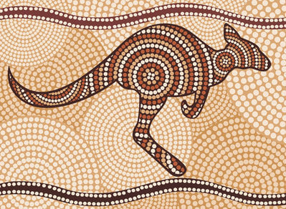
Perhaps we can learn from the Indigenous Australians who have sustainably managed Australian lands for up to 50,000 years.
There is evidence that they mined for minerals such as ochre for almost 40,000 years. Ochre provides the brown pigment in Aboriginal artwork!

Slide 34
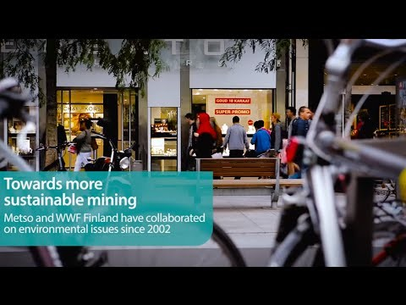

Slide 35
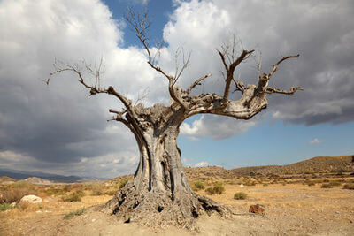
As you might expect, making the mining of uranium sustainable provides extra challenges.
Sustainability isn't just about managing how we use resources. It's also about reducing pollution - the harmful chemicals we put back into the environment. Uranium radiation can contaminate water and air, and kill plants and animals. How do we avoid these nasty effects?

Slide 36
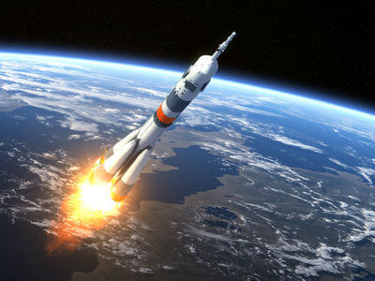
Earlier, you saw that waste from uranium mining can be stored in a tailings pond, like the one at Ranger Mine. The water in the pond shields living things from the radiation.
However, there's only so much room to throw drums of radioactive waste. People are still looking for a better solution. Some have even considered shooting waste into the Sun on a rocket!
What do you think we should do with all this waste?

Slide 37
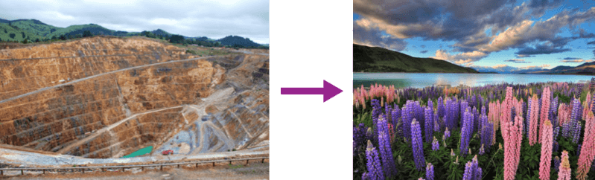
Eventually, every mine runs out of ores to dig up. Afterward, the mine can be rehabilitated, which means it is given back to nature.
All the holes are filled in with soil and water, and trees are planted. Rehabilitation makes the site look just as it was before mining began. This helps make mining more sustainable because, after a mine closes, it's as if humans were never digging there!

Slide 38

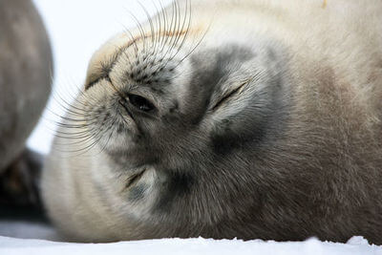
Scientists need to work together to find ways of reducing the impact mining has on the environment. This is one of today's biggest challenges!
It's our duty to protect the environment, so the other residents of planet Earth can sleep easy.

Slide 39
Dredging is another type of mining method.
This method can be used when minerals are found in sand and a large lake can be dug and filled with water.

Slide 40
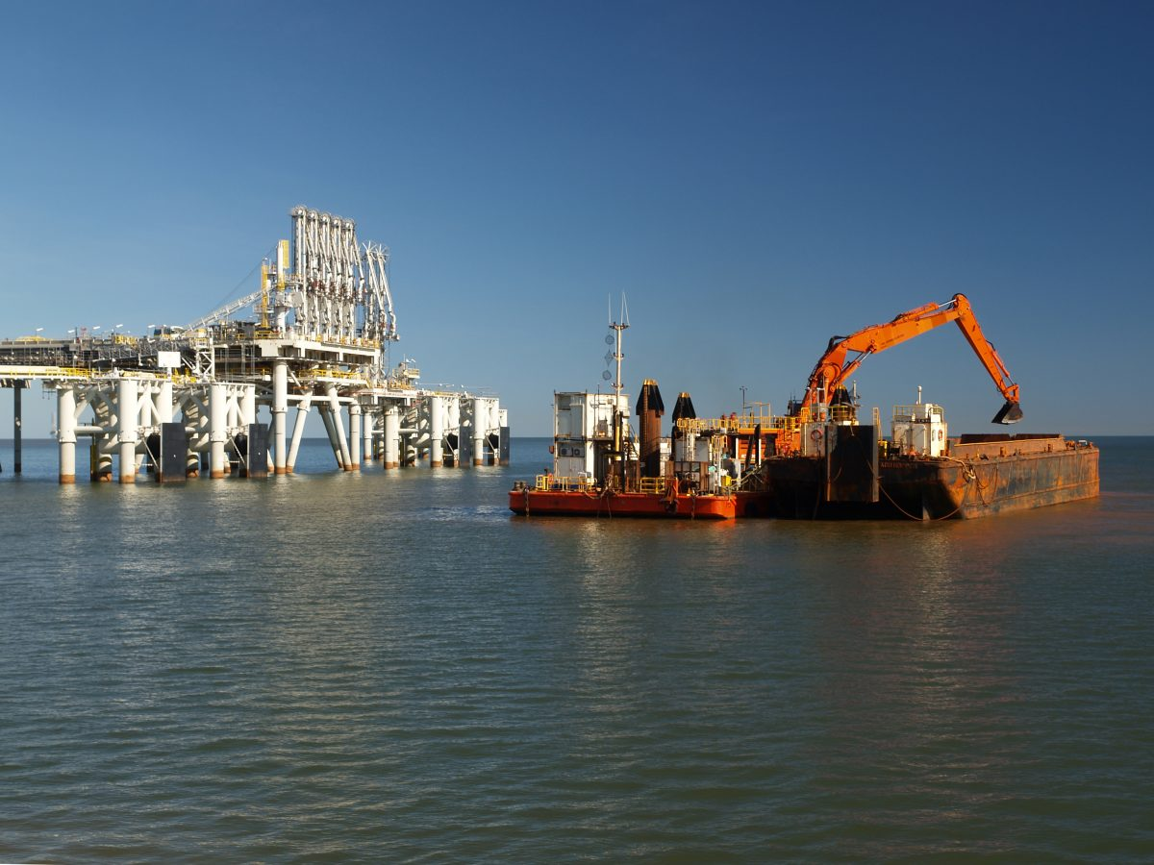
A large pit is dug and filled with water to create a small lake. Then a dredging boat is floated on the surface. As you can see, the boat then uses large hoses to suck up the sand. The minerals are heavier than sand and so are easily separated from it when in water. The sand and the water are then pumped back into the lake.

Slide 41
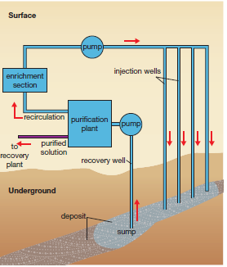
Another type is leach mining.
Some materials can be mined by dissolving them in fluid that is injected into the ore body.
The process begins by drilling bore holes into the ore deposit.
A solution that will dissolve the ore, called a leach solution, is pumped into the ore. The dissolved ore in solution is then pumped to the surface through a second bore hole.

